Slide 1
Website And App Design
Head : Arnav Srivastava
Associate Head : Harsh Yadav
Core Team Members : Yashveer Talan
Ayush Kumar
Anushka Omar

Slide 2
NEED :
Awareness
Publicity
Interaction
Social Reach
Collaborations
Marketing
Availability
Community Building
Online Platforms

Slide 3
Functionality of Entrepreneurship Cell :
Providing Solutions We tend to provide the solution to the above needs through Website and Android App
Our Website

Slide 4
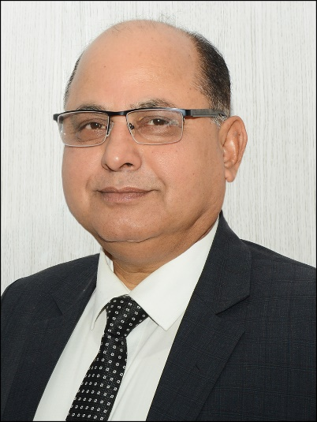
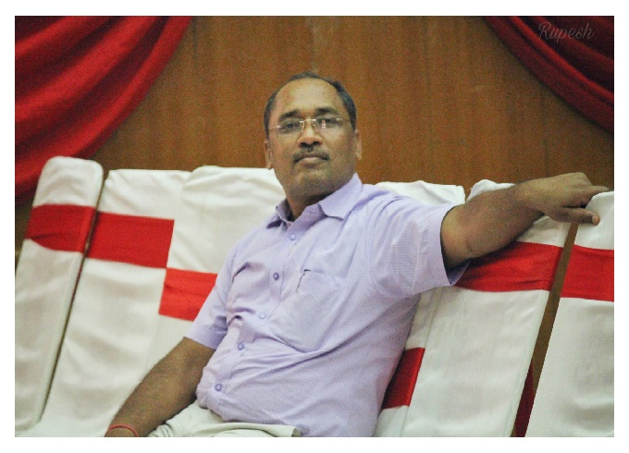
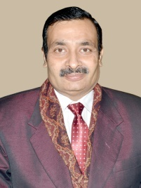
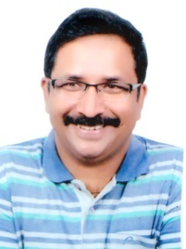
Index Page :
Incubation Hub
This page Details about the hierarchy of the Incubation Hub.
This hierarchy is the backbone of Incubation hub.
The first and the top most is our Honourable V.C. Sir. Then there is Dean of Incubation Dr. Krishna Raj Sir. Associate Dean of Incubation, Mr. S.K.Gupta sir and Coordinator of Startup Cell, Mr. A.K.Rathore Sir are accompanied by many Faculty Advisors. In the end, three student cells are there. One of them is ours “GIIEC”, Genx Innovation Incubation and Entrepreneurship Cell.

Slide 5
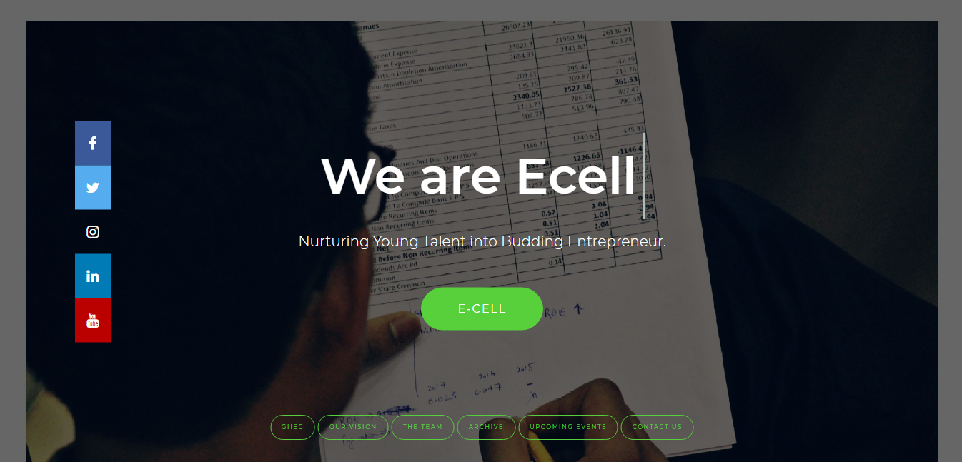
This Page Is The First Page For The Student’s Cell, GIIEC. It Contains The Link Of Every Other Page In The Website.
We are E-Cell :

Slide 6

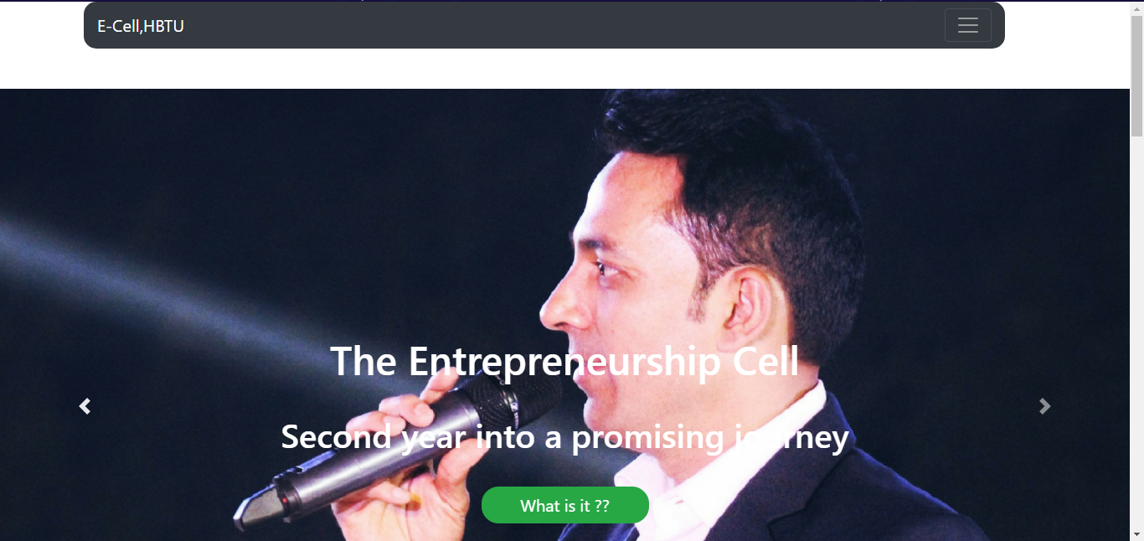
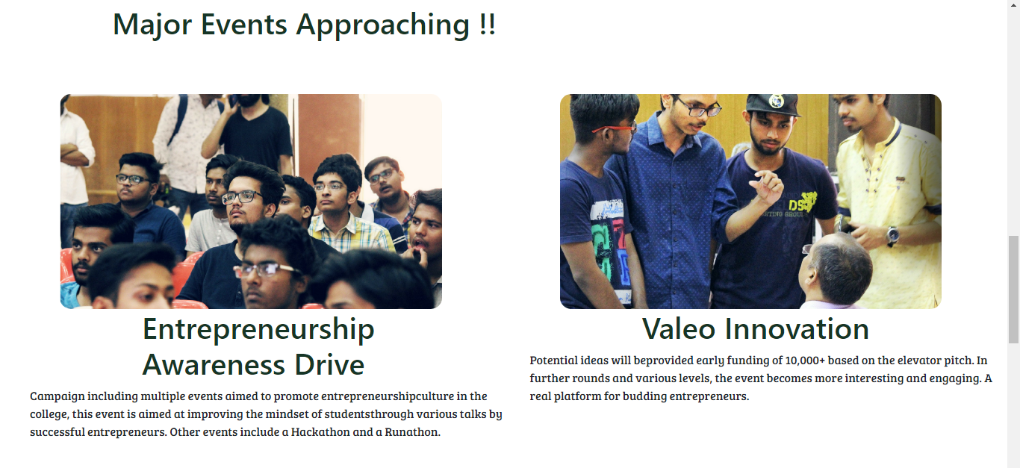
GIIEC :
This is the page which contains major information about GIIEC. It gives the glimpse of the upcoming events and acts as a directory to many other pages.

Slide 7
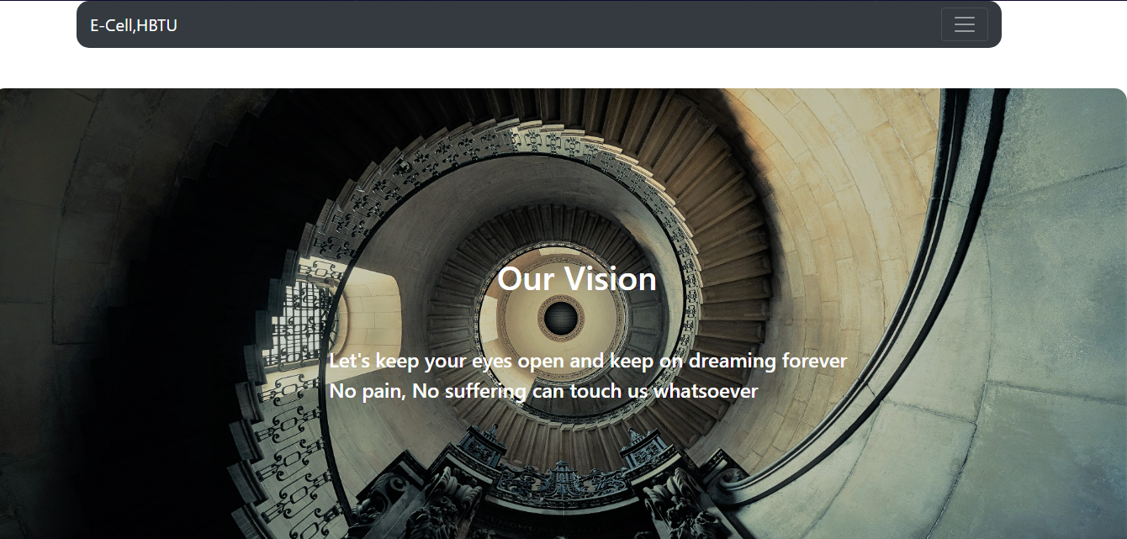
Our Vision :
This Page declares Our Visions and what we believe and what we stand for.

Slide 8
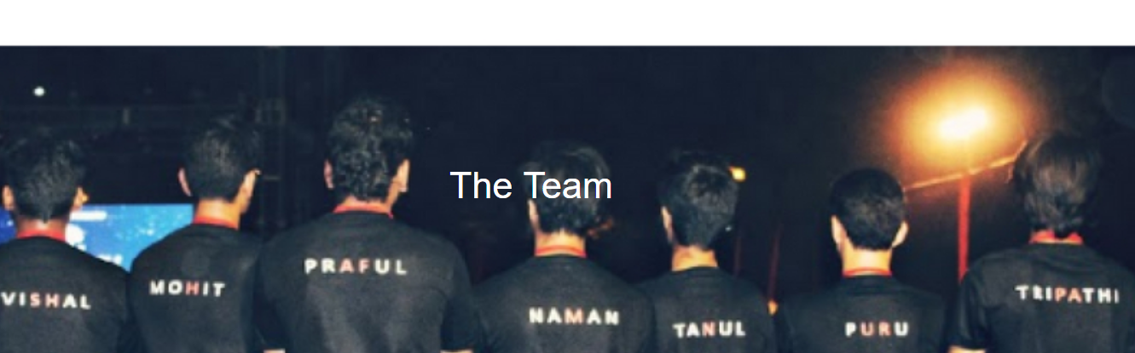
The Team :
This Page Lists The Members of The Team which will Stand Tall To Accomplish Our Goals and Reach to The Point Where Our Vision Takes Us.

Slide 9
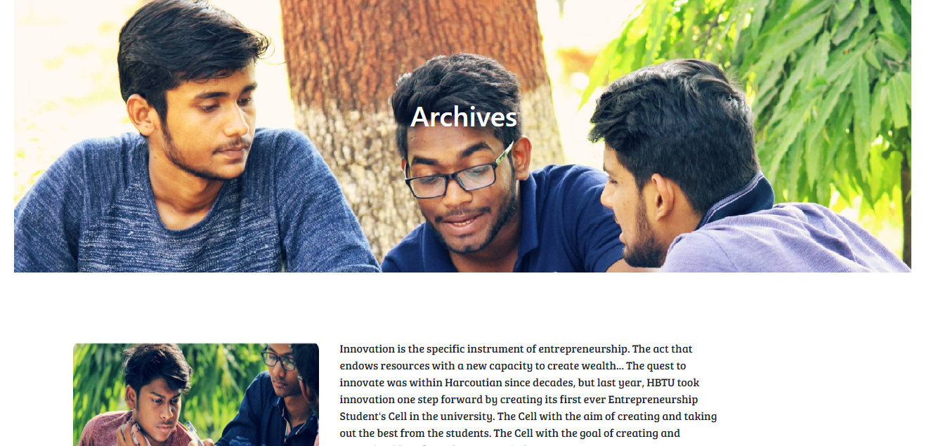
Archives :
This Page gives a brief Description of What Happened Last Year , The First Year of GIIEC.

Slide 10
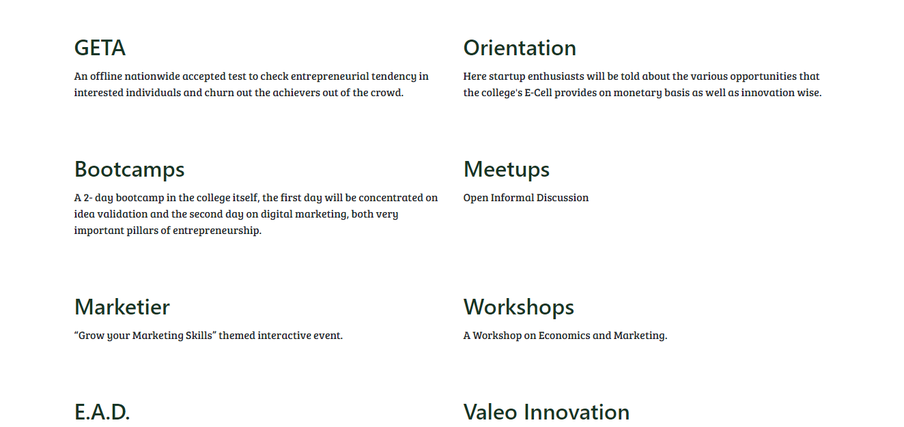
Upcoming Events :
This Page Describes the Main Events Going Down This Year For Which Budding Entrepreneurs Can Actively Participate

Slide 11
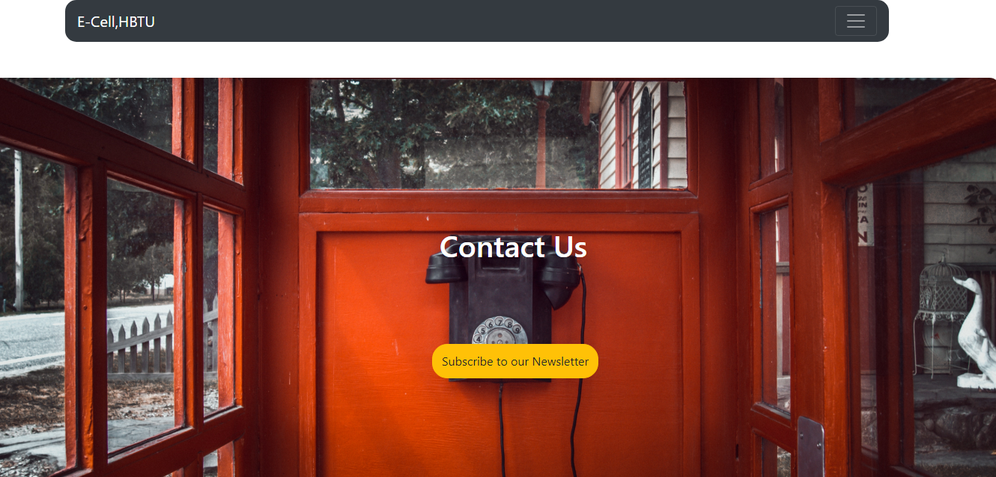
Contact Us :
This Page Provides The Students To Directly Contact The Team. They Could Subscribe To Our Newsletters.

Slide 12
Major Significance of App :
Personal Connection
The Most Powerful Tool: Notification
Registrations
Maintaining Database and Our Primary Audience
Blog Contributors
Instant Feedback
Advertisement of Sponsors

Slide 13
Future Vision :
BINDER
Binder is an Event for the Budding Entrepreneurs and for the students looking for applying and enhancing their newly developed skills. This will develop a culture in the college which will enhance more upcoming start-ups and entrepreneurs.

